Slide 1
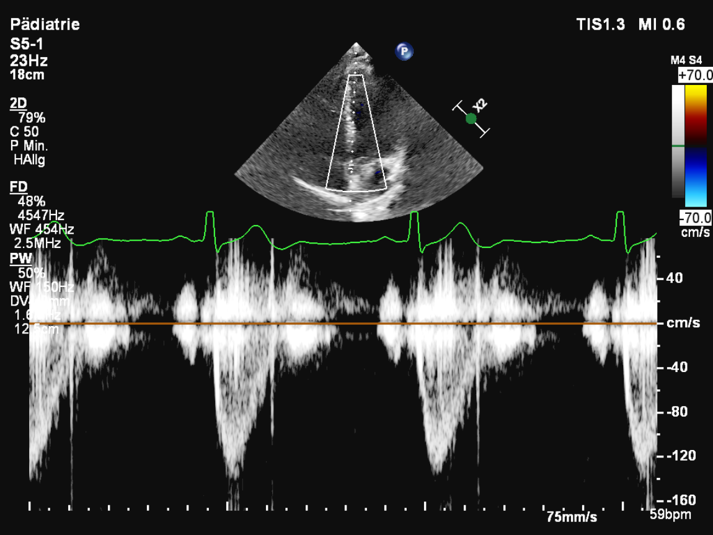
Pre-ejection period = time between R wave and flow-onset
Total-systolic period = time between R wave and end-flow

